Slide 1
B.Tech. Artificial Intelligence and Data Science
Semester: 7
Capstone Review 2
Academic Year: 2025-26
Presented by : Soham Hande – A129
Aryan Turalkar- A152
Aryan Kohli – A167
Faculty Mentor: Dr. Chhaya Dhavale

Slide 2
Proposed System Features
Title: SMB Autopilot: An Autonomous Multi-Agent Decision & Compliance Framework
for Indian MSMEs
Scattered and Inconsistent Records:
Small businesses receive records in mixed formats—paper receipts, photos, WhatsApp PDFs, and Excel sheets where every vendor labels columns differently. None of this data feeds into a central database.
No Link Between Stock and Available Cash:
Purchases are planned without checking real-time bank balances. Stock is ordered to prevent running out, while cash is held back for rent and payroll. Neither side has visibility into what the business can actually afford to spend at that moment.
Bottleneck at the Business Owner:
Because no system connects inventory requirements to bank balances, the owner has to review and approve every single purchase manually. When the owner is occupied, orders stall—leading either to stockouts or excess unsold goods.
Unchecked Invoices and Billing Errors:
Without an accounting or audit team, incoming bills are rarely verified line by line. Wrong GST calculations, duplicate bills, and simple addition errors get paid out without anyone catching them.

Slide 3
Proposed System Features
Title: SMB Autopilot: A Multi-Agent AI Framework for Autonomous Business Operations in Small and Medium Enterprises
Module 1: Data Intake & Digitalization Engine
  Extracts text from receipts and invoice images using EasyOCR with CLAHE contrast tuning, deskewing, and a SHA-256 memory cache.
  Standardizes messy headers into a universal schema using a 3-tier resolver (Core Tax fields → Domain Extensions → Catch-all JSON attributes).
  Automatically detects business type (Fashion, Food, Electronics) using HSN codes and item semantic keywords, auto-saving clean rows into SQLite.
Module 2: 2-Agent Reasoning & Conflict Arbitrator
  Inventory Agent: Queries inventory_items in real time, flags items where Stock < Threshold, and recommends restock purchases (e.g., "Reorder SKU-001 for ₹50,000").
  Finance Agent: Computes free liquid cash (Bank Balance − Payroll Reserve) and sets a hard expenditure ceiling (e.g., "Maximum budget allowed = ₹20,000").
  2-Agent Arbitrator: Intercepts the conflict. It caps the ₹50,000 request to the ₹20,000 ceiling, recalculates the exact unit quantity that fits the budget, and generates an explainable decision card.
Module 3: Cryptographic Audit Ledger & Payment Settlement
  Pre-Payment 3-Way Math Audit: Verifies line items (Subtotal + Tax = Total) before any transaction is authorized.
  SHA-256 Audit Ledger: Chained hashing of every ingestion event, agent recommendation, and approval into audit_ledger, with a verify_chain() function to prove logs are tamper-free.
  Conditional Settlement: Releases mock vendor payments and flips invoice status to "PAID" only after passing arithmetic checks and audit verification.

Slide 4
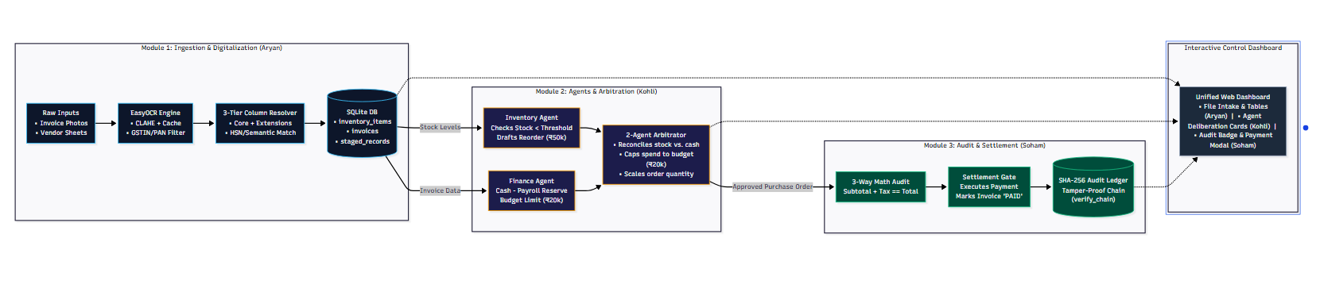
System Design

Slide 5
Challenges Faced during Project Development
Deadlock Between Inventory and Finance Agents:
  The problem: The Inventory Agent tries to buy large batches to make sure stock never runs out (e.g., requesting ₹50,000). At the same time, the Finance Agent sees upcoming salary dates and blocks all spending above ₹20,000. Without an arbitrator, the system gets stuck and makes no decision.
  How we fixed it: We wrote an arbitration engine. It treats the liquid cash limit as a hard wall, calculates how many units can be bought within that ₹20,000 limit, and creates an adjusted purchase order so buying doesn't stop completely.
Preventing Working Capital & Payroll Risk in the Finance Agent:
  The problem: A business might have ₹1,00,000 in the bank, but ₹80,000 of that is needed next week for payroll and rent. If an agent looks only at total bank balance, it could spend that money and cause a cash crunch.
  How we fixed it: The Finance Agent enforces a protected reserve formula: $\text{Available Budget} = \text{Bank Balance} - \text{Payroll Reserve} - \text{Emergency Buffer}$. Only the remaining cash is allowed for inventory reorders.
Inconsistent Vendor Spreadsheets and Receipt Photos:
  The problem: Every supplier names columns differently (e.g., Rate, Price per unit, unit_cost), and paper bills come with bad lighting, wrong tax calculations, or missing HSN codes.
  How we fixed it: We built a 3-tier resolver that maps synonyms, verifies line-item math ($\text{Subtotal} + \text{Tax} = \text{Total}$), and saves any unknown custom columns into a JSON field so SQLite never breaks.
Tamper-Proof Tracking for Autonomous Decisions:
  The problem: If agents make automated buying decisions, simple database logs can be edited or deleted if something goes wrong.
  How we fixed it: We implemented a SHA-256 hash-chain audit ledger. Each new decision links to the hash of the previous one. If any past record or price is altered, the chain breaks and triggers an instant alert.

Slide 6
Tools and Technologies
Python 3.11 & FastAPI:
The main programming language and backend API. FastAPI runs the agent evaluation loops, file ingestion endpoints, and serves data to the frontend.
Multi-Agent Logic & Pydantic:
Custom agent logic built in Python. Pydantic models define strict inputs and outputs for each agent so they can exchange structured data without type errors.
EasyOCR & OpenCV:
Used to read text from invoice photos and receipts. OpenCV cleans the image (removes tilt and boosts contrast), and EasyOCR extracts the text on CPU with SHA-256 caching so repeat tests are instant.
SQLite & Dynamic JSON:
Our primary database. Stores stock levels, invoices, and purchase orders. Non-standard vendor columns are stored in an attributes JSON field so we don't have to alter table columns for different industries.
Cryptographic Hashing (SHA-256):
Used for two things: instant OCR caching by hashing raw file bytes, and linking every agent decision in a tamper-evident audit ledger.
React + Vite & TypeScript:
The frontend control panel. Displays live stock warnings, agent decision cards (Inventory vs. Finance vs. Arbitrated), and the final approval modal.

Slide 7
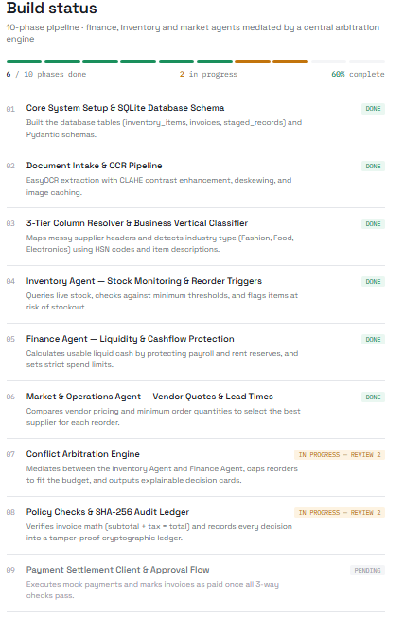
PROGRESS REVIEW

Slide 8
Thank You

